Slide 1


Requirement Analysis for a
Road State, Sign and
Notification App
SafeWaka
Group 4

Slide 2
Outline
What is requirement analysis?
Requirement Prioritization
Functional Requirement
Non-Functional Requirement
Conclusion

Slide 3
Introduction to Requirement Analysis
Requirement analysis is a critical first step in developing any successful software application. It involves thoroughly understanding the client's needs, pain points, and desired outcomes to define a clear set of functional and non-functional requirements.

Slide 4

Objectives of the Road Sign and Road State Mobile Notification Application
Provide real-time updates on road conditions, traffic, and hazards to drivers and commuters.
Enable users to report and share information about potholes, construction sites, and other road obstacles or changes.
Improve safety and reduce accidents by alerting drivers to speed limits, stop signs, and other critical road signs.

Slide 5

Functional Requirement(1/3)
High priority
Real time traffic update.
Location based services
Automatic start and stop
Display road sign
User feedback and collaboration
Audio Notification

Slide 6
Functional Requirement(2/3)
Medium priority
Navigation assistance.
Data visualization
Route Optimization

Slide 7
Functional Requirement(3/3)
Low priority
Integration with exiting traffic monitoring system.
User incidence reporting
Easy sharing of captured video footage on Youtube

Slide 8
Non-Functional Requirement(1/2)
High priority
Performance
1- Responsiveness
2- Low latency
3- Battery efficiency
Medium priority
Usability
1- Intuitive interface
2- Minimal distraction
3- Voice control option

Slide 9
Non-Functional Requirement(2/2)
Medium priority
Data management
1- Road sign information source
2- Real time data acquisition
3- Data update mechanism
Low priority
Security
1- User privacy
2- Data security

Slide 10
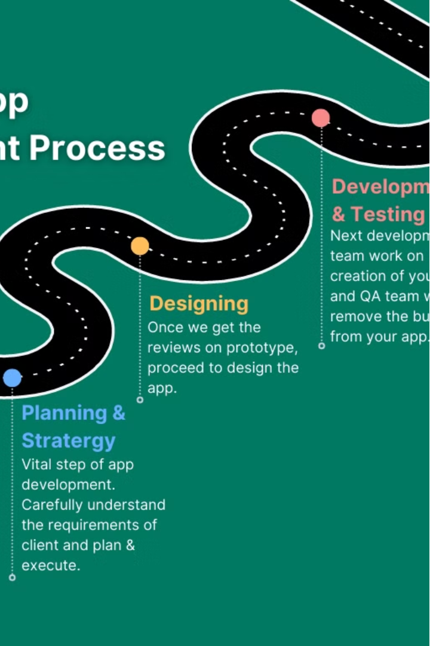
Conclusion
In conclusion, the requirement analysis for the Road Sign and Road State Mobile Notification application has uncovered a clear need for a comprehensive solution to improve driver safety and commuter experience. By leveraging real-time crowdsourced data, proactive alerts, and seamless integration with navigation, this app has the potential to significantly reduce accidents and frustrating delays.

